Slide 1


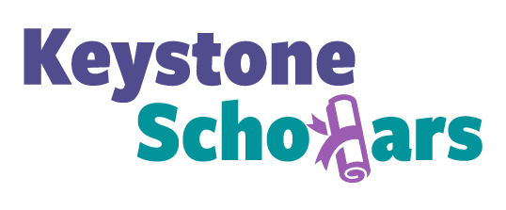


Keystone Scholars –
partnering to achieve financial, educational, and health outcomes
Medicaid Home Visiting Expansion Workgroup
May 5, 2021
PENNSYLVANIA TREASURY | BUREAU OF SAVINGS PROGRAMS
Notes:
Introduce myself
Will give you an update on our Keystone Scholars program and some new initiatives.
Child Development Accounts continue to be an intriguing and promising solution to one of our country’s and state’s biggest problems, And one that fits squarely amidst our respective missions and has impacts on financial, educational and health outcomes.
That is the high cost of postsecondary education AND the challenges in getting kids from lower income families and communities to attend and complete postsecondary education.

Slide 2
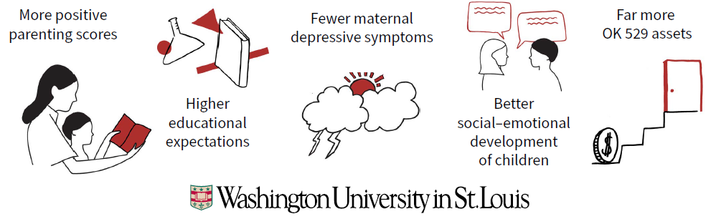
CDAs Have Positive Impacts On Parents And Children
Source: Huang, J., Beverly, S. G., Kim, Y., Clancy, M. M., & Sherraden, M. (2019). Financially vulnerable families
reap multiple benefits from Child Development Accounts (CSD Research Brief No. 19-40). St. Louis, MO:
Washington University, Center for Social Development.
Notes:
Brief background: CDAs are long-term savings accounts that offer incentives to families, especially low-income ones, to save for their children’s post-secondary education.
Research has provided strong evidence that CDAs have positive impacts on both parents and children.
It shows that engagement with a CSA leads to
-more positive parenting scores
-higher educational expectations
-reduced maternal depression and improved mother’s interactions with her children.
-better social-emotional development of children.
-and more savings for future education
These effects were shown to be greater for mothers with lower income and education.
CSAs improve early childhood development and academic performance; the most disadvantaged children gained the most.
Their research also shows that CSA programs can have more significant effects when offered together with social services.

Slide 3

PA Has First Legislated Universal At-birth CDA In The US
$100 for every baby born to PA resident on/after Jan 1, 2019 or subsequently adopted
Invested in PA 529 Guaranteed Savings Plan
No taxpayer dollars
To be used for qualified higher education expenses between ages 18 to 29
Families may open and save for their child in their own PA 529 account and link it to their Keystone Scholars account
Notes:
A reminder of our Keystone Scholars program. Some of you from Luzerne County worked with us on our pilot in 2018.
We are very proud that Pennsylvania has the first and largest universal, automatic child development account program beginning at birth in the country which has legislation behind it. The program went statewide on Jan 1, 2019.
The funds can be used for higher education expenses when the child turns 18 up until age 29.
We encourage families to open their own PA529 account and save in addition to the Keystone Scholars funds.
The program is funded by surplus earnings in our PA529 Guaranteed Savings Plan and the Funds are held in an omnibus account in that plan. We encourage families to open their own PA529 account and save alongside, and The child will need a 529 account when they are ready to use the Keystone Scholars funds.
Our aim is threefold:
1) Help parents maintain high expectations for their child’s future education; recent survey of Keystone Scholars families showed that all parents of newborns, no matter the demographics or income, expect that their child will go to college. But then life and challenges often get in the way.
And its important to intervene early
2) Helping activate the child’s own identity as someone who will go on to college or other postsecondary education.
Research has shown that children with a savings account, even with a very modest amount, are three times more likely to pursue attending a 2 or 4 year college, and 4 times more likely to graduate. But when we talk about going on to college, we mean any kind of post high school education, including trade or vocational school, community college, and now even apprenticeships.
3) prompt parents to start saving as early as possible – when it has the most time to grow

Slide 4
Keystone Scholars Program Update
By Income Status | 2019 Cohort Registration Rate
Moms on WIC | 7.35%
Moms not on WIC | 15.11%
Key Keystone Scholars Stats | As of 5/1/2021
Accounts Funded | 263,188
Total Registered | 28,268
Percent Registered | 10.74%
Percent Registered with a linked PA 529 | 20.52%
By Race of Mom | 2019 Cohort Registration Rate
Black | 7.39%
White | 14.41%
Asian | 16.60%
Bureau of Savings Programs
Notes:
PA has about 135,000 births per year, and we now have over 250,000 accounts created and funded – births through Nov 2020.
We are recognized as one of the leading, most innovative programs in the country. Being Statewide, legislated gives us a lot of opportunity.
One of the most important metrics we look at is how may people have registered and logged into their accounts. That percent typically hovers at 10-11%
We need to get that up – if parents and kids don’t know about the accounts, it won’t do them any good.
For 2019 cohort of babies, the registration for lower income families Is lower. We use WIC participation as a proxy for low-income status.
It was 6% for moms on WIC vs about 13% for babies born to non-WIC moms.
Babies born to mothers on WIC account for about 30% of the births in the state. We’ve got to get that registration rate up.
We also have 2019 cohort registration rates broken down by race. Large differences in registration by race. 6% for black moms vs double that for white and Asian mothers.
This is where we need you.

Slide 5


New: Bright Future Booster
Additional $50 Keystone Scholars deposit
For babies born between January 1 - June 30, 2021 to WIC participants
Moms must be enrolled in WIC at time of child’s birth.
WIC agencies and advocates are supporting outreach efforts.
Notes:
We have a new program intended to provide additional deposits targeted to low-income families
$50 subsidy provided to all PA children born Jan 1-June 30, 2021 to mothers enrolled in the Special Supplemental Nutrition Program for Women, Infants and Children (WIC).
In addition to the universal $100 KS starter deposit.
It is funded by philanthropic funds and a settlement Treasury received.
Though a modest additional deposit, it represents an important step in building onto the Keystone Scholars program in a way that addresses existing inequities and promotes wealth-building among some of our state’s most disadvantaged families.
From nutrition education to college graduation is tagline WIC suggested

Slide 6
Milestone Program – incenting WIC enrollment
New program building on the Bright Future Booster
5-year incentive program exclusive to babies of Adagio Health’s WIC participants
Children will receive additional deposits into their Keystone accounts for each year they remain enrolled in WIC, until their 5th birthday.
Being replicated by other agencies
Milestone | Deposit
Birth | $50
1 Year | $50
2 Years | $50
3 Years | $75
4 Years | $100
5 Years | $100
Subtotal | $425+ $100 Keystone Scholars Deposit= $525
Notes:
Building on that, a WIC agency in western PA created a milestone program to incent continued participation of the child in WIC to the maximum age of 5.
additional deposits will be made each year into their Keystone Scholars accounts for as long as the participant remains in the WIC program – so up until their 5th birthday.
The grand total that one can receive would be $525.
We’re very happy that interest has come in from another, large WIC provider to replicate this program in other parts of state….We want to encourage other partners to do similar initiatives.

Slide 7

How Can Medicaid Home Visiting Be Involved?
Integrate Keystone Scholars During Medicaid Home Visits
  Share information on the program and provide materials
  Help parents access their accounts online
  Let families know they will receive a letter from PA Treasury 3 to 5 months after giving birth with more information
Notes:
Is there money coming from American Rescue Plan that could be considered ‘early scholarships’?

Slide 8

Treasury Makes It Easy To Share Information
Available Tools
  Brochures
  Flyers/Handouts
  Content Outreach Tools
  Social Media Tools
  Coloring Sheets
  Bookmarks
  Posters
  Parent Education Slides
  Short Videos
  Webinars for Parents/Families
1

Slide 9
Treasury Makes It Easy To Share Information
Available Tools
  Brochures
  Flyers/Handouts
  Content Outreach Tools
  Social Media Tools
  Coloring Sheets
  Bookmarks
  Posters
  Parent Education Slides
  Short Videos
  Webinars for Parents/Families
1

Slide 10

Thank You
Julie Peachey
Deputy State Treasurer, Consumer Programs
jpeachey@patreasury.gov
www.pa529.com/keystone
PENNSYLVANIA TREASURY | BUREAU OF SAVINGS PROGRAMS

